Slide 1
On Statical testing of Hypothesis in National Income
By Susmita Sagar
Roll no - 202124

Slide 2
Introduction
All about National Income:-
National Income refers to the money value of all the goods and services produced in a country during a financial year. In other words, the final outcome of all the economic activities of the nation during a period of one year, valued in terms of money is called as a National income.

Slide 3
Methodology of National Income Estimation in India: In India, the estimation of national income is being done by two methods:- 1.Product method 2.Income method
Economic activities include all the human activities that produce goods and services that can be valued at market price. Such as production by farmers, production by firms in different industrial sectors, production of goods and services by government, services produced by business intermediaries

Slide 4
Statistical Hypothesis It is a hypothesis that is testable on the basis of observed data modelled as the realised values taken by a collection of random variables having a joint probability distribution in some set of possible joint distributions. The hypothesis being tested is exactly that set of possible probability distributions.

Slide 5
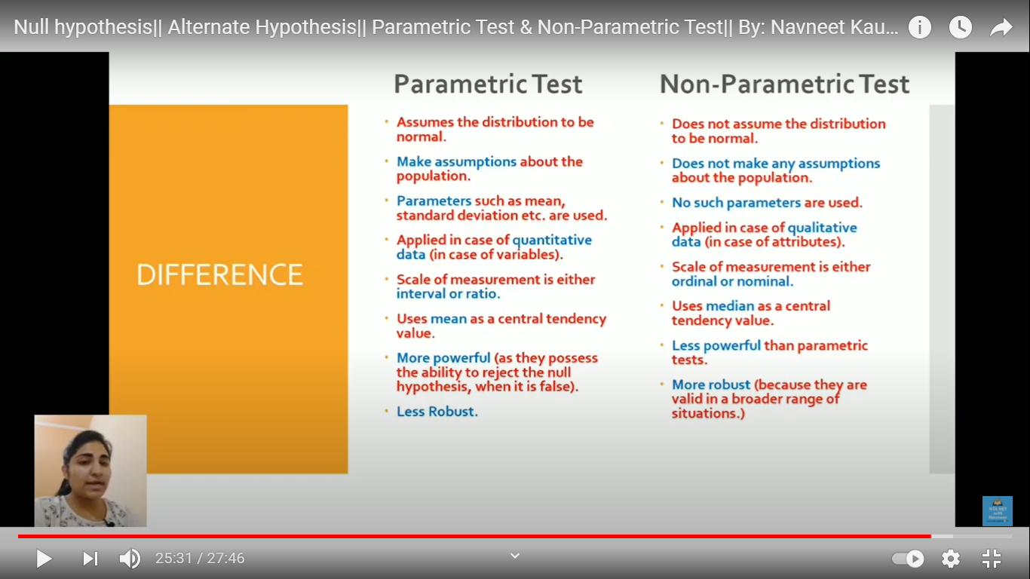
Comparison between Parametric Test and Non-Parametric Test.
All statical tests are being performed on only null hypothesis and it is considered as true until we find evidence against it.
At the end as a result either the null hypothesis is rejected or accepted.

Slide 6
More about Hypotheses testing
Hypotheses may be closer to reality, by attempting to include as many realistic elements as possible. But we shall never find any exact agreements with statistical data . Here our concern is whether certain relations can be established as statistical average laws. We may say that such laws connecting a certain set of specified entities are exact in a statistical sense if they, when the number of observations becomes very large, they approach in the limit a certain form which is virtually independent of elements not included in our model.
When seen at a large scale, statical hypothesis can’t give us exact data . calculation is based on our imaginary assumptions.

Slide 7
Hypothesis
Null Hypothesis(H ₀ ) Alternate Hypothesis(Ha)
hypothesis testing
Statical Test Parametric Test
Non-Parametric Test

Slide 8
Null Hypothesis and Alternative Hypothesis
“Null Hypothesis (H₀)” is assumed to be true – the way a defendant in a jury trial is presumed innocent until proven guilty by the evidence presented in court. Similarly, hypothesis testing starts by stating and assuming a “null hypothesis,” and then the process determines whether the assumption is likely to be true or false.
The important point to note is that we are testing the null hypothesis because there is an element of doubt about its validity. Whatever information that is against the stated null hypothesis is captured in the Alternative Hypothesis (H_{a})
The alternative hypothesis is a direct contradiction of the null hypothesis.
As in a trial, the jury assumes the defendant's innocence (null hypothesis). The prosecutor has to prove otherwise (alternative hypothesis). Similarly, the researcher has to prove that the null hypothesis is either true or false.
If the researcher fails to prove an alternative hypothesis (or simply does nothing), then the null hypothesis is assumed to be true.

Slide 9
Null hypothesis Alternative Hypothesis
H₀ | H_{a}
equal (=) | not equal (≠) or greater than (>) or less than (<)
greater than or equal to (≥) | less than (<)
less than or equal to (≤) | more than (>)

Slide 10

Hypothesis testing
P > 0.05 is the probability that the null hypothesis is true. ...
A statistically significant test result (P ≤ 0.05) means that the test hypothesis is false or should be rejected.
A P value greater than 0.05 means that no effect was observed
Where,
x is the raw score,
μ is the population mean,
σ is the population standard deviation.
n<30 .
Sample standard deviation is unknown.

Slide 11
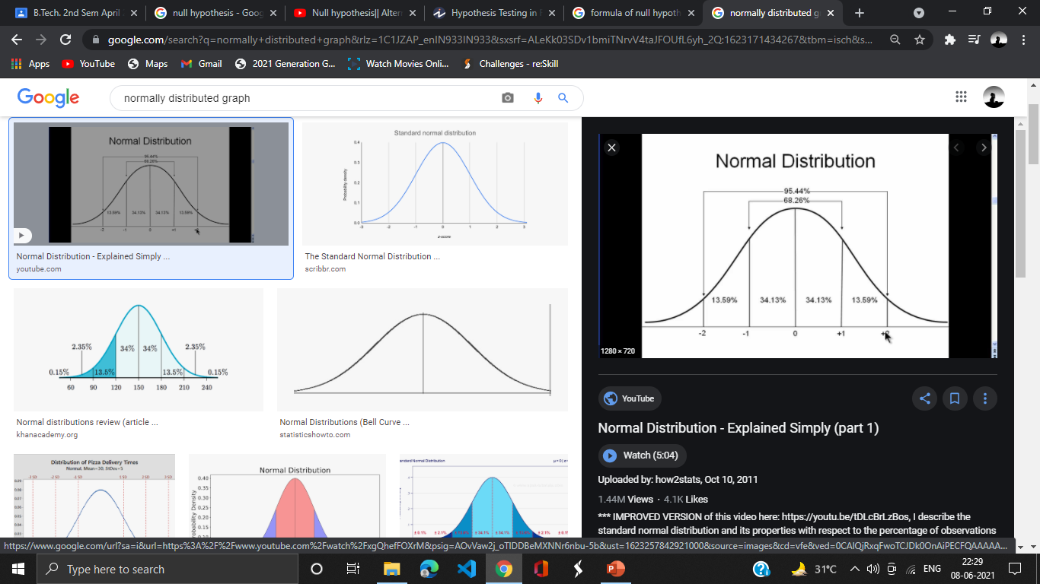
Hypothesis testing strategies
There are two types of tests of hypotheses
Parametric tests
( standard test of hypotheses):-
Usually assume certain properties of the
population from which we draw samples.
Quantitative data
Observation come from normally distributed populatio
Sample size is small.
Population parameters like mean, variance, etc. are hold good.
Requires measurement equivalent to interval scaled data.

Slide 12
2.Non-parametric tests (distribution free test of hypotheses).
Non-Parametric tests;-
Does not under any assumption
Assumes only nominal or ordinal data
Non-parametric tests need entire population (or very large sample size)
Population is not normally distributed. (skew or uniform distribution)
Parameters like mean , standard deviation ,mode are not used.
Data is qualitative

Slide 13
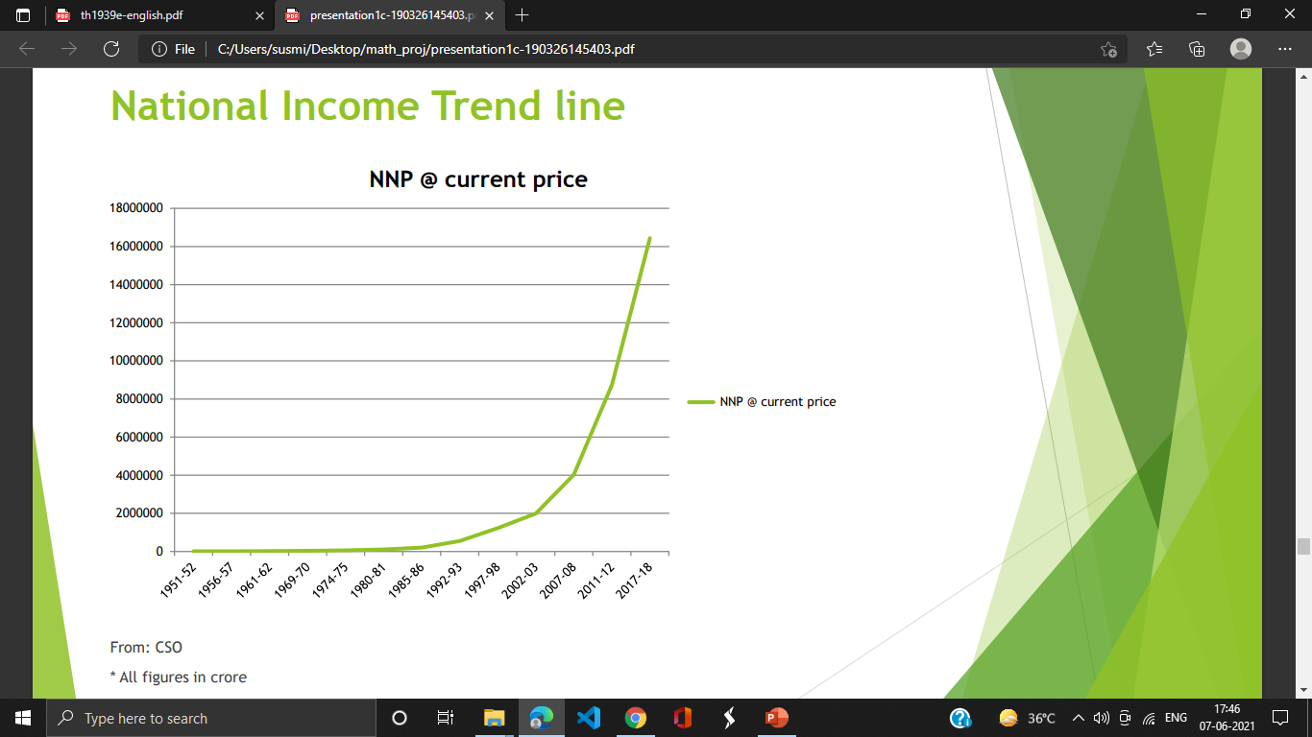
National income trend line Nominal Net National Income (NNP), also known as National Income (at Current Prices) is likely to be ₹181.10 lakh crore during 2019-20.

Slide 14
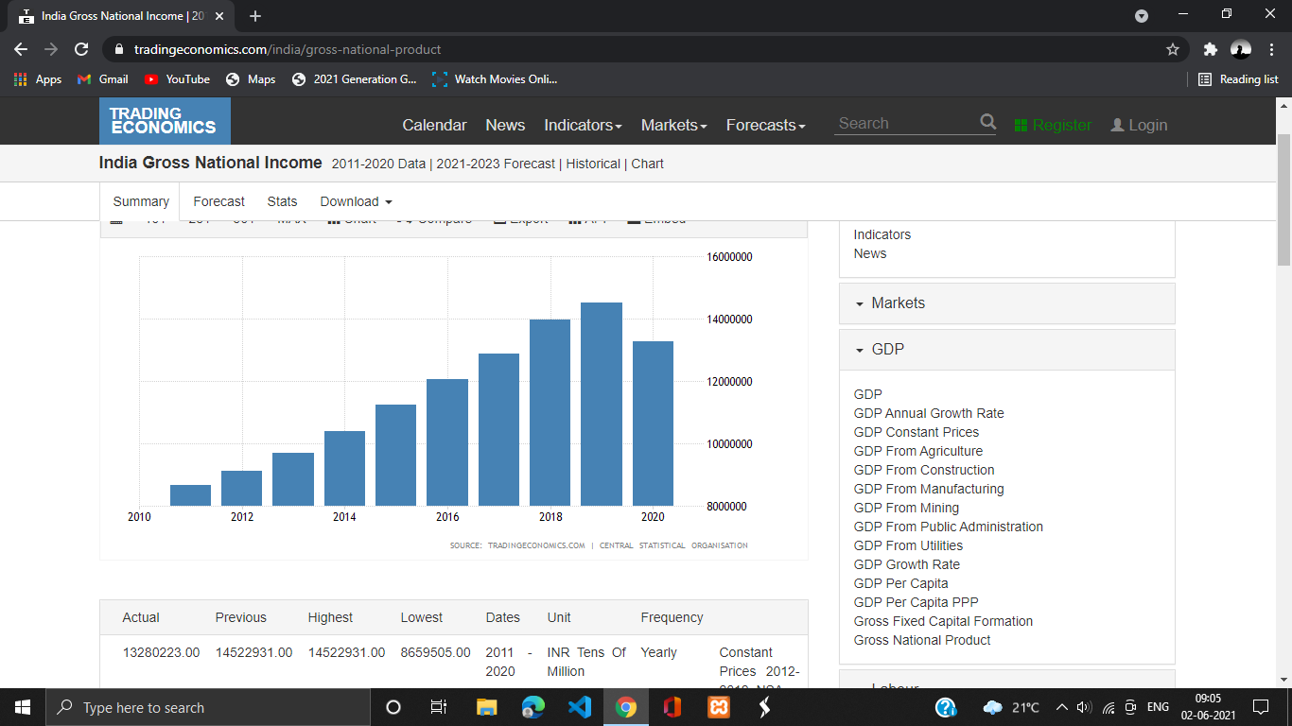
In 2020 National income decreased due covid

Slide 15
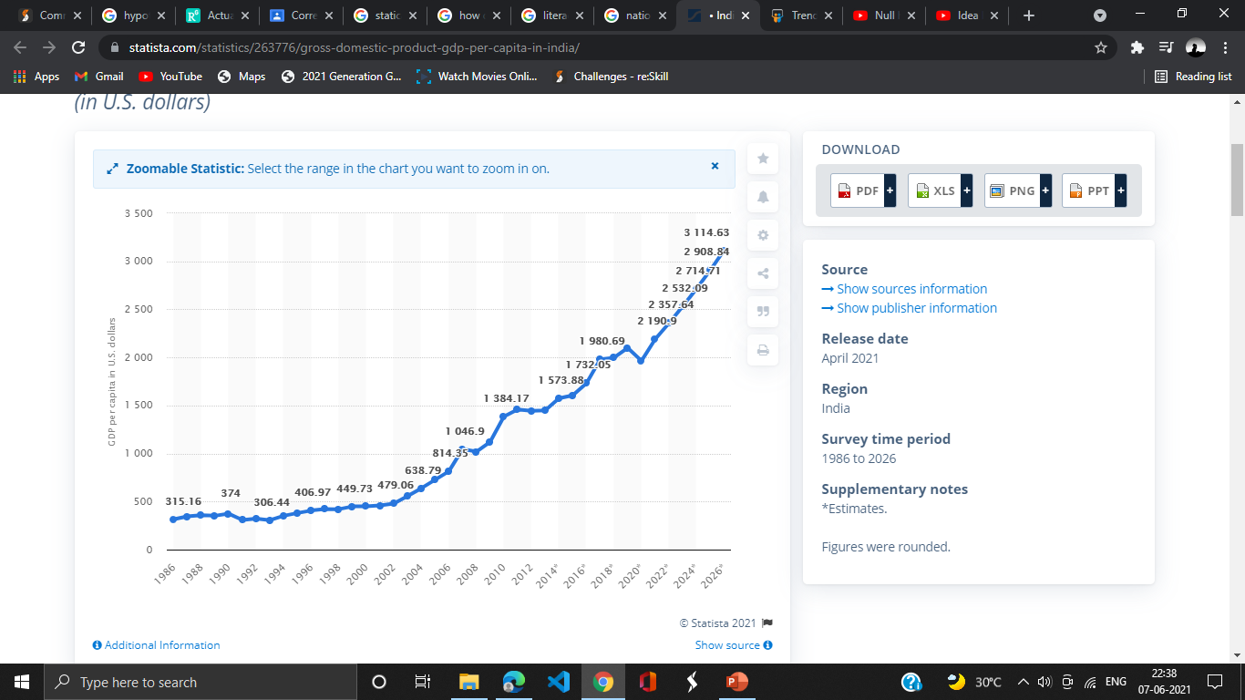
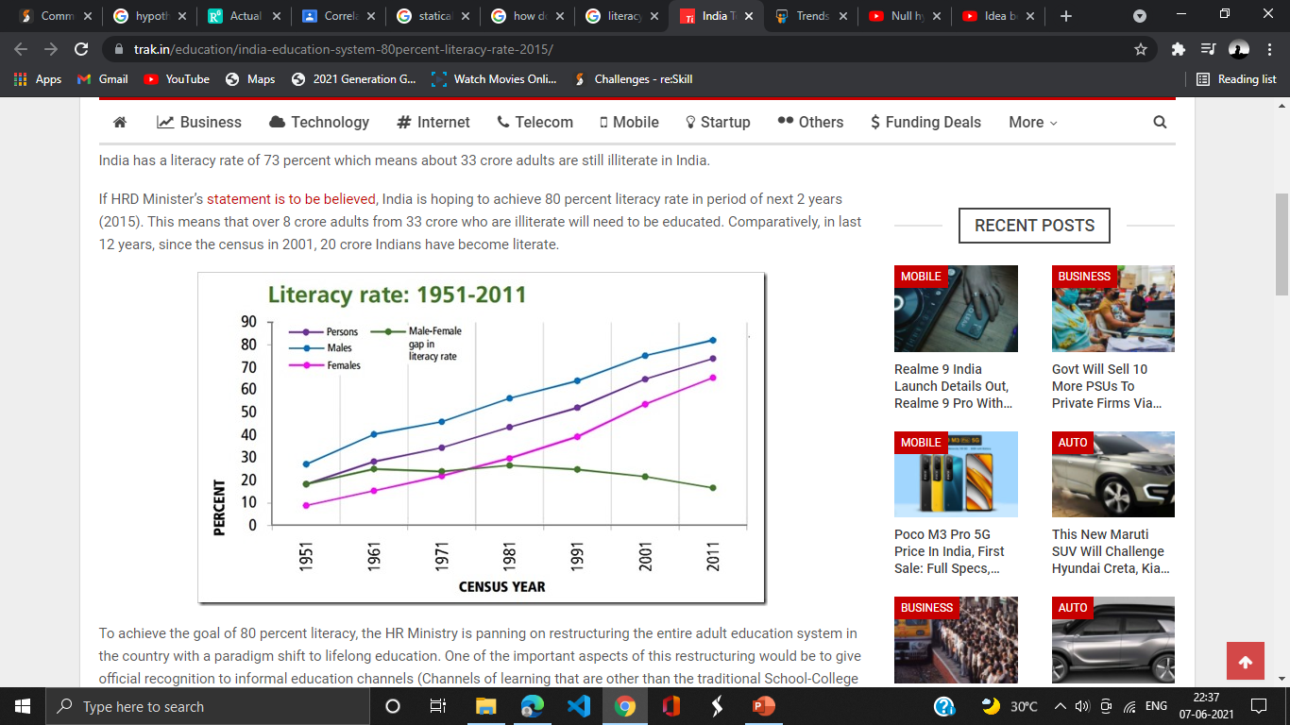
Comparison in Graph between Literacy rate and National Income of India. HYPOTHESIS 1:- With the passing time , national income increases as the literacy rate increases.

Slide 16
Hypothesis testing on literacy of India.
investigation of the following hypothesis is done:
H0: Literacy rate has no strong impact on the economic progress of India.
H1: Literacy rate has a strong impact on the economic progress of India.
To study the relation between literacy rate and GDP in India, hypothesis has been done.
The literacy rate of India in present is 74.37%. In 2001 it was 65.38%.
Population in the year 2001 is1,028.74 million, and number of literates are 561 million.
From formula of proportion we will calculate z and from p value we get the final decision . we perform it at 95% confidence level.
reference from Office of the Registrar General & Census Commissioner, India.

Slide 17
Calculation
Formula for z =(p’-p0)/√[p0(q0)]/n
p’= 561/1028.74 = 0.545 , q0 = 1-p0 = 0.346 , n =1028.74
p’-p0 = -0.109
Our z after calculation is 519.048 . Two tailed.
p = 0.00001 that means p < 0.05
By calculation alpha is less than p so we reject the null hypothesis and this means that our national income has a strong impact of literacy rate .
As the result shows a very high positive correlation between literacy and GDP, the null hypothesis (H0) is rejected and the research hypothesis (H1) is accepted. Thus literacy having a strong impact in the economic progress of India can be verified from the above result. If India’s GDP is considered over the past few decade, it has been increasing with an increasing growth rate in general. This growth rate has also had its effect on the literacy rate in turn increasing the literacy rate. However there are certain challenges as just being literate will not guarantee access to jobs.

Slide 18
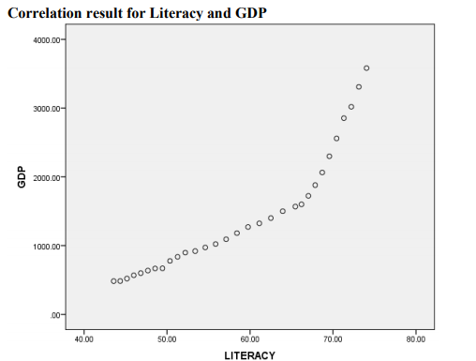
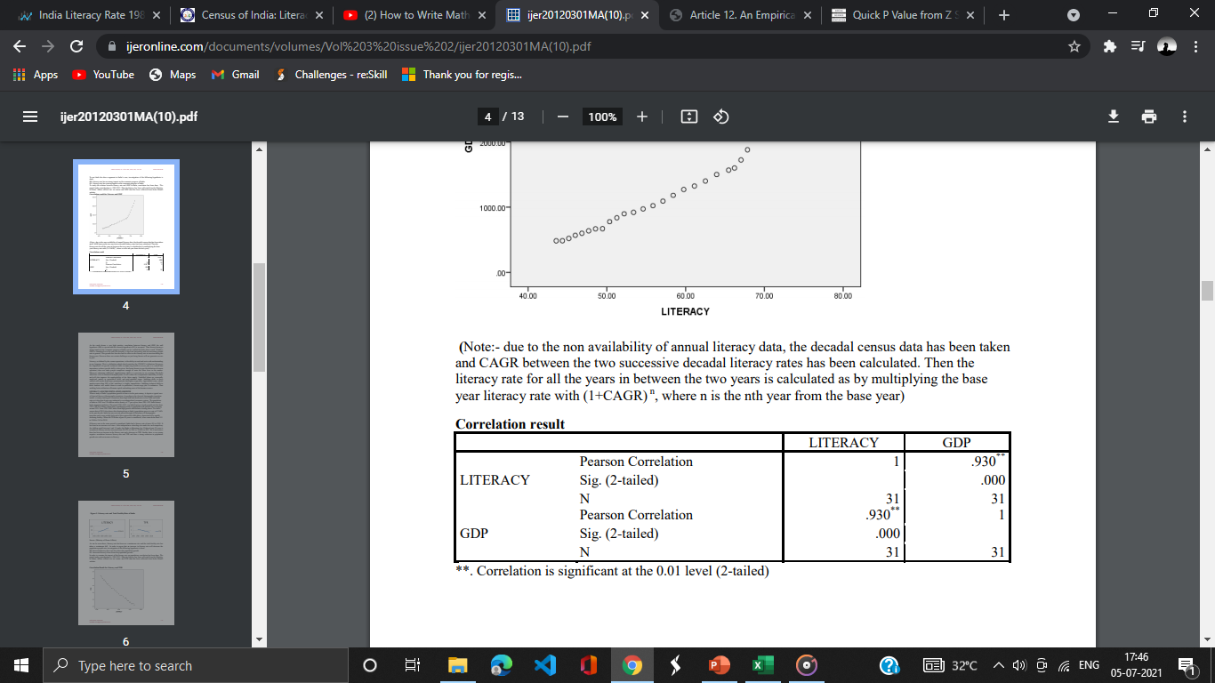
Graph between GDP and literacy
The increase of 13.75% in literacy rate in the last one decade, marks a recognition of the combined efforts in the field of elementary education and adult education through the total literacy campaigns.
Reference from ijeronline.com

Slide 19
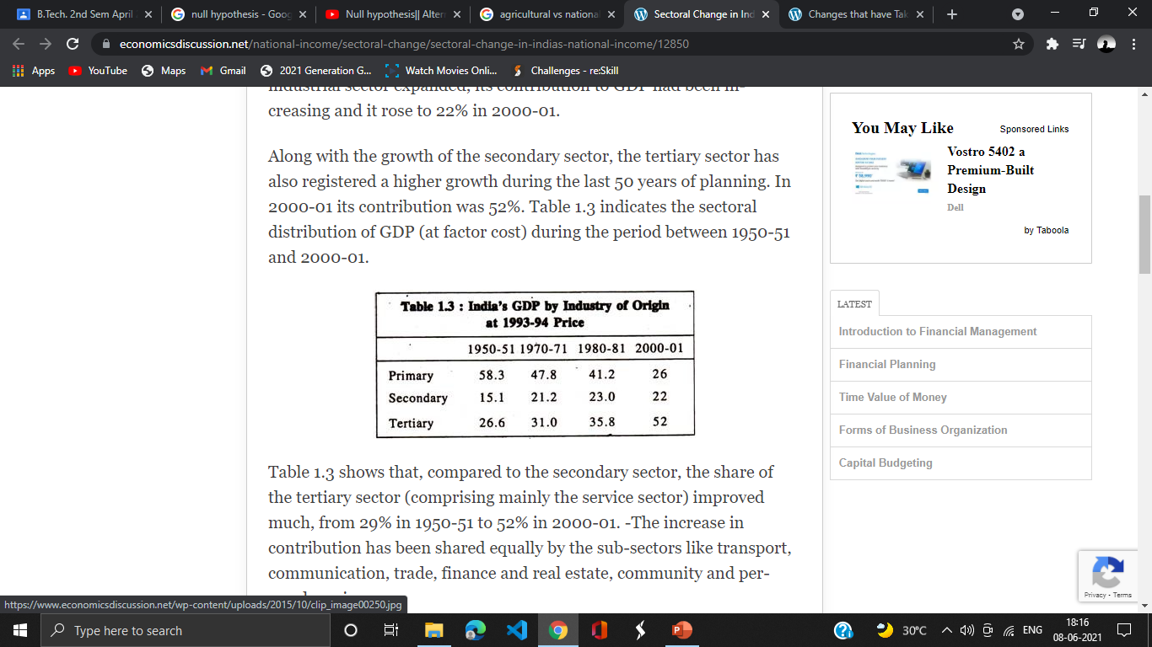
HYPOTHESIS 2:- with time as the agriculture sector of India declines, our national income increases.
Agriculture is an important sector of Indian economy as it contributes about 17% to the total GDP and provides employment to over 60% of the population.
The per capita income of the agriculture sector declines to 1/3 of the national per capita income during the recent years.
Referanc from

Slide 20
Hypothetical analysis on agricultural sector
Let agricultural sector contribute 16.11% to GDP.
H0 = 0.1611
Ha > 0.1611
Total income (2014) ,
Agricultural sector = 366.92 dollar billion
Total income combined primary , secondary and tertiary sector = 2,048.33
P’=366.92/2048.33 = 0.179
Q0= 0.839
z = (p’-p0)/√p0q0/n by calculating this and at level of confidence of 99%
Significant α = 0.01
Its critical value Zc = 2.576

Slide 21
The P-Value is .004998. The result is significant at p < .01.
means our agricultural sector has less than 16.11% contribution in national income as per the current scene.
Over the past few decades, the manufacturing and services sectors have increasingly contributed to the growth of the economy, while the agriculture sector’s contribution has decreased from more than 50% of GDP in the 1950s to 15.4% in 2015-16 (at constant prices).

Slide 22
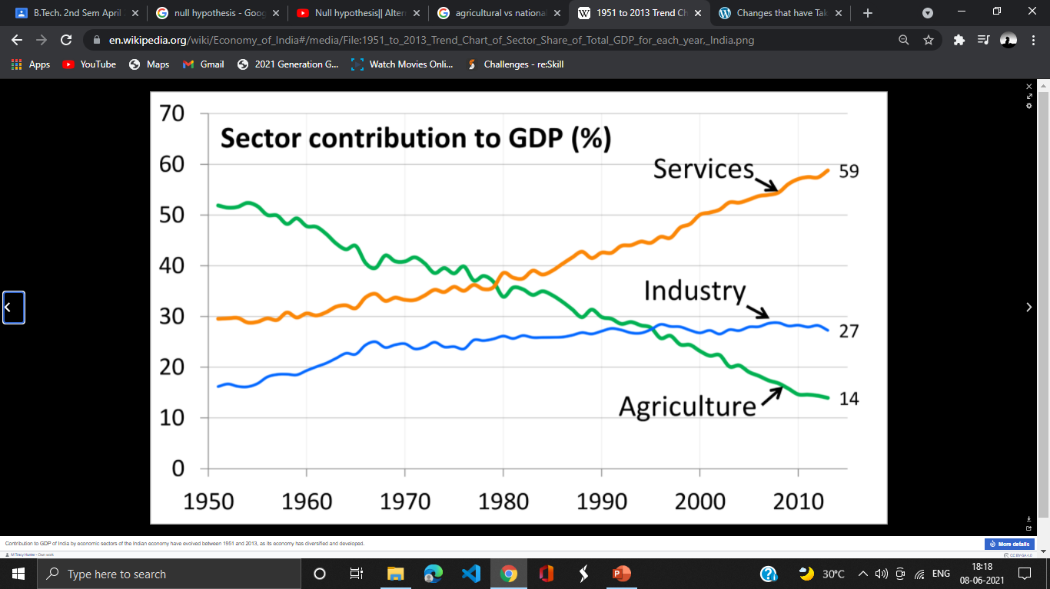
As the Agricultural sector decline, our national income is increased.(inversely proportional )

Slide 23
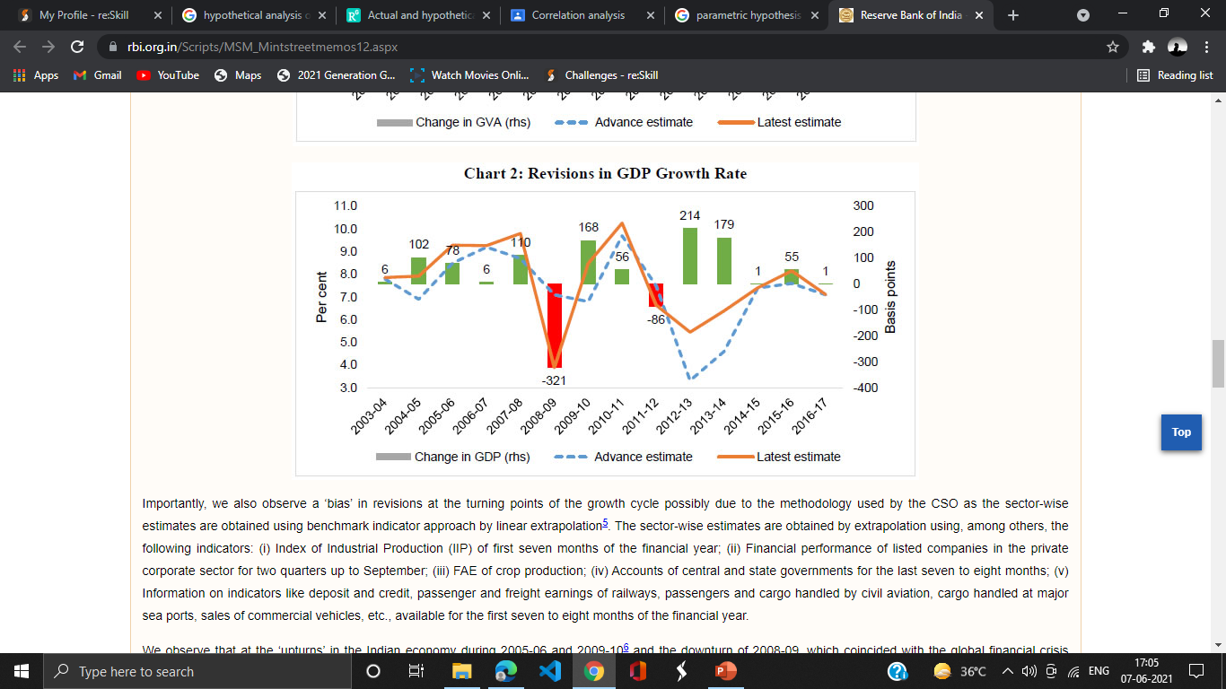
GDP growth rate
In the case of real GDP, Advance Estimates ( AEs) were revised upwards in twelve years and only in two years were there revisions in a downward direction.
We observe that at the ‘upturns’ in the Indian economy during 2005-06 and 2009-10 and the downturn of 2008-09, which coincided with the global financial crisis (GFC), there have been huge revisions in the subsequent ).
On the other hand, for 2008-09, the CSO revised real GDP growth downward from 7.1 per cent in AE to 3.9 per cent in final estimates (overestimation of around 320 basis points).
# The Central Statistics Office (CSO) is a governmental agency in India under the Ministry of Statistics and Programme Implementation responsible for co-ordination of statistical activities in India, and evolving and maintaining statistical standards.

